Slide 1

Synthetic Approaches to Creating Hole Transport Materials
Jacob Shoulders
April 19th, 2025
Arizona Space Grant Consortium Statewide Symposium
1

Slide 2
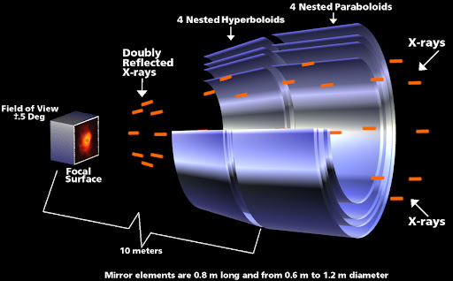
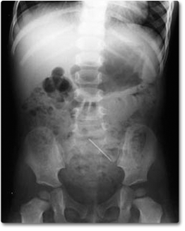
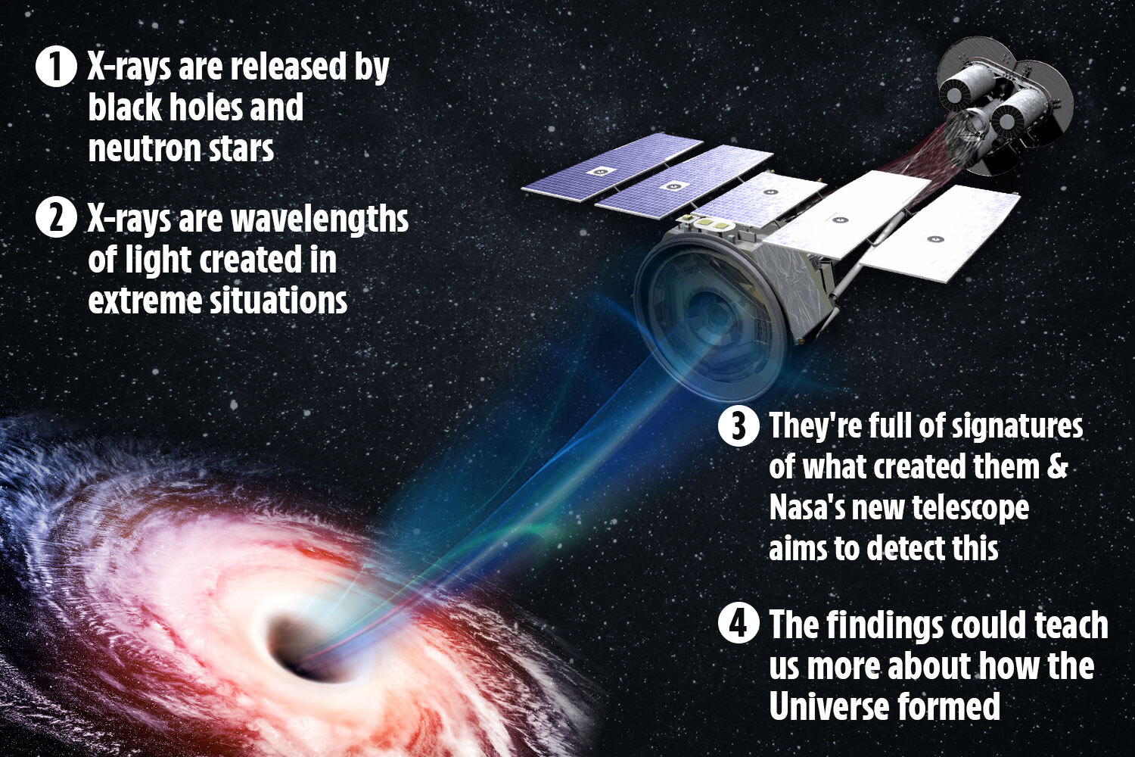
What Is X-ray Detection? Why Is It Important
What is the connection between solar cells and X-ray detection?
The use of X-ray detection by astronauts is vital to entities in space such as:
Black holes
Pulsars
Supernovae
Helping to develop technologies for space travel and medicine. (Reference 2)
Space X-ray telescope
https://darkmatterdarkenergy.com/2015/04/21/x-raying-dark-matter/
Human X-ray imaging
edhelper.com/reading_comprehensions/How-Do-X-Rays-Work.htm
How these telescopes could be used:
https://www.the-sun.com/lifestyle/tech-old/4233120/nasa-x-ray-telescope-black-holes-universe/

Slide 3
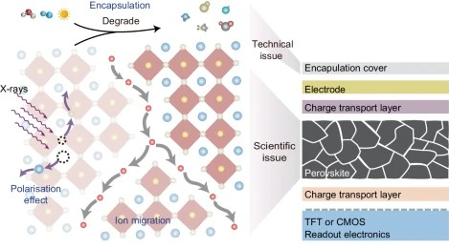
Introduction to Hole Transport Materials
Hole transport layers all stem from something known as an electron hole:
A location in a semiconducting material that is positively charged, which form from differing energy levels.
Effectiveness depends on ability to cancel out negative charge.
A hole transporting material like Sprio-MeOTAD must be smooshed between anode (+) and cathode (-) layers of an X-ray detector for maximum efficiency. Alternation can help with this. (Reference 3)
https://www.nature.com/articles/s41467-024-50179-2
Notes:
Hole transport layers all stem from something known as an electron hole:
A location in a semiconducting material that is positively charged.
Formation comes from missing electrons that create an electron-hole pair because of differing energy levels between the valence and conduction bands present.
Electron-holes have the ability to move through a material like minute molecules. Their overall effectiveness will depend on their capacity to cancel out negative charges.
A hole transporting material like Sprio-MeOTAD must be smooshed between anode (+) and cathode (-) layers of an X-ray detector for maximum efficiency. We can use alternated versions of the molecule to improve perovskite detectors for X-ray detection.

Slide 4
The Project at Hand
Figure 1: Chemical Structure of Spiro Molecule
This project focused on a hole transport layer in perovskite X-ray detectors called Spiro-MeOTAD. (Reference 3)
Many synthetic strategies were attempted, with one favoring over all others.
All synthesized complexes were examined via NMR and UV-Vis.
Perovskite X-ray detectors play a vital role in medical imaging and NASA related planetary research. (Reference 2 and 3)
Figure 2: Chemical Structure of Spiro-MeOTAD

Slide 5
Synthesis and Characterization
Scheme 1: Synthesis of 2,7-dibromo-9-fluoreneone (Reference 4)
Scheme 2: Synthesis of 2',7’-dibromospiro[dibenzo[c,h]xanthene-7,9'-fluorene] (Reference 2)
Notes:
The synthesis of 2,7-Dibromo-9-fluorenone (Scheme 1) was prepared using 9H-fluoren-9-one in deionized water with an excess of liquid bromine. Solution refluxed for sixteen hours in a preheated sand bath. Purification consisted of simple filtration with deionized water
(1) was then synthesized with naphthalen-1-ol and worked up with POCl₃ for nine hours to create 2',7'-Dibromospiro[dibenzo[c,h]xanthene-7,9'-fluorene] (Scheme 2) Anhydrous ethanol was used to filtrate the final product.

Slide 6
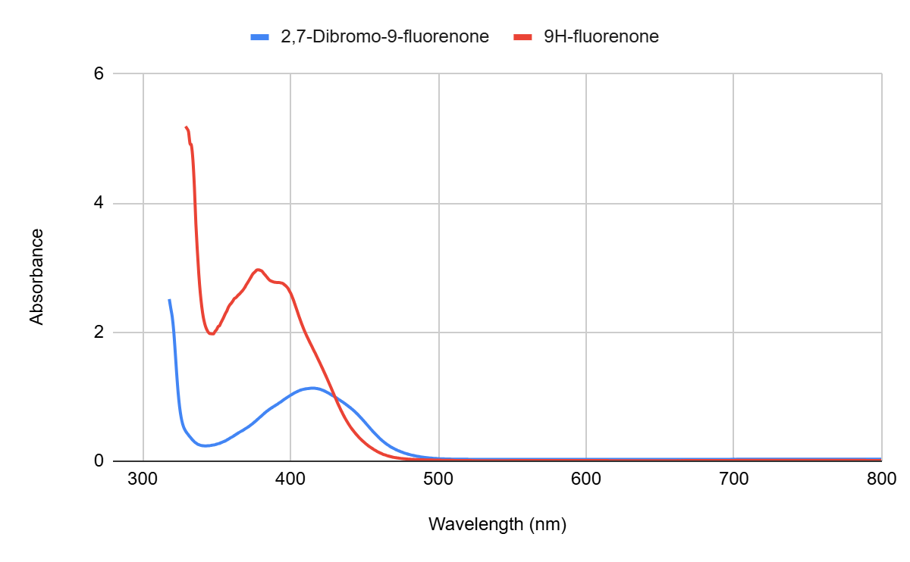
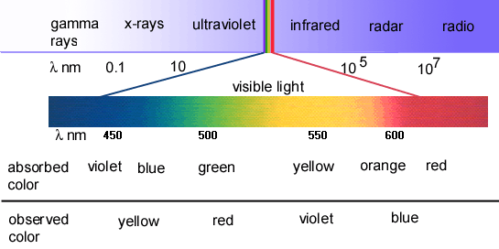
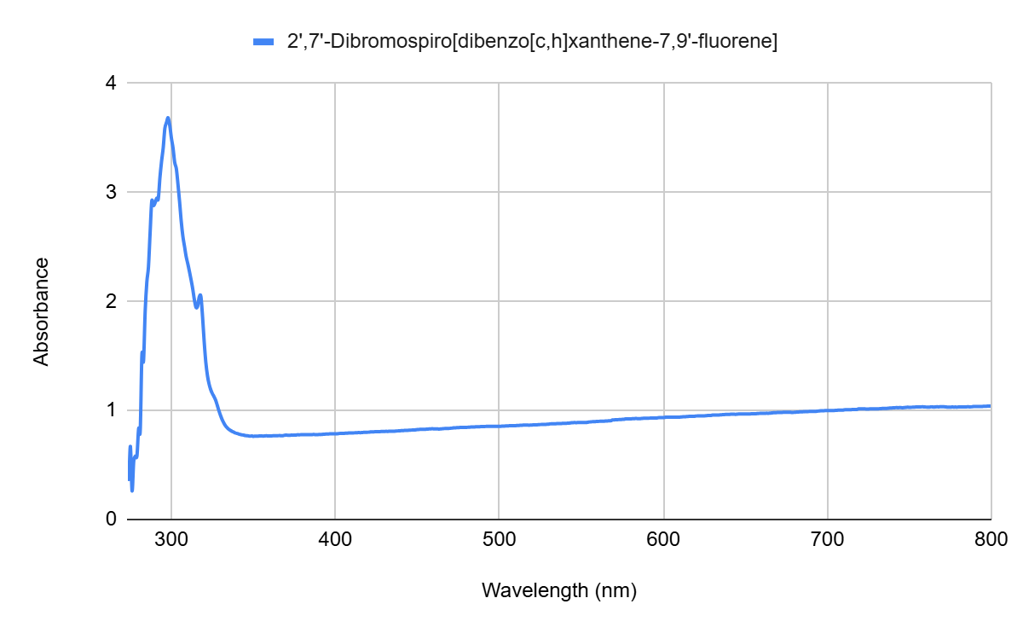
Synthesis and Characterization – UV-Vis
The 9H-fluorenone λ_{max} peak occurs at 377 nm and 2,7-dibromo-9-fluorenone’s λ_{max} peak is at 415 nm. The shift can be attributed to the larger conjugated pi system of the brominated complex.
https://www.curioustem.org/stem-articles/the-electromagnetic-spectrum-infra-red-radiation-visible-light-ultraviolet-radiation
2',7'-Dibromospiro[dibenzo[c,h]xanthene-7,9'-fluorene] λ_{max} peak is 298 nm.
Notes:
The 9H-fluorenone λmax peak occurs at 377 nm and 2,7-Dibromo-9-fluorenone’s λmax peak is at 415 nm. The shift can be attributed to the larger conjugated pi system of the brominated complex.
2',7'-Dibromospiro[dibenzo[c,h]xanthene-7,9'-fluorene]’s λmax peak is 298 nm.

Slide 7
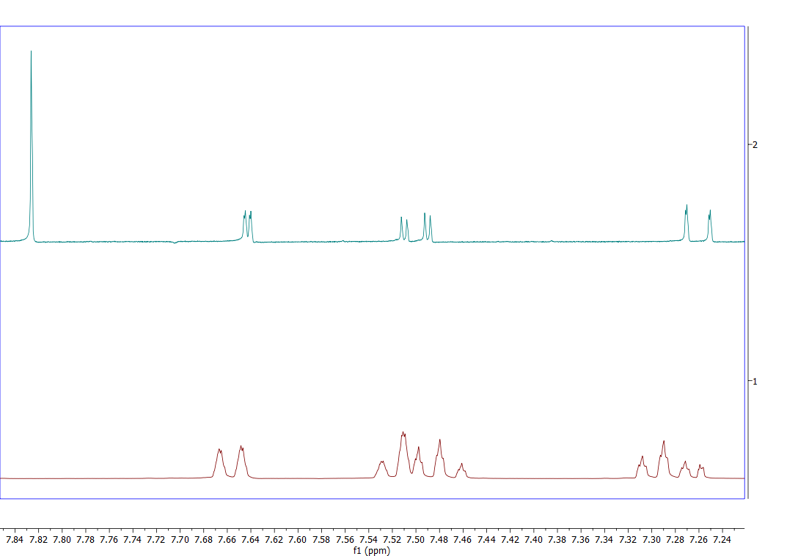
Synthesis and Characterization – NMR (1/2)
Notes:
The NMR spectra showcase the comparison of the regular 9H-fluorenone vs. the 2,7-dibromo-9-fluoreneone on the left side and compare the Spiro[dibenzo[c,h]xanthene-7,9'-fluorene] to the Dibromo Spiro[dibenzo[c,h]xanthene-7,9'-fluorene] on the right side.
STILL NEED TO INPUT NMR SPECTRA

Slide 8
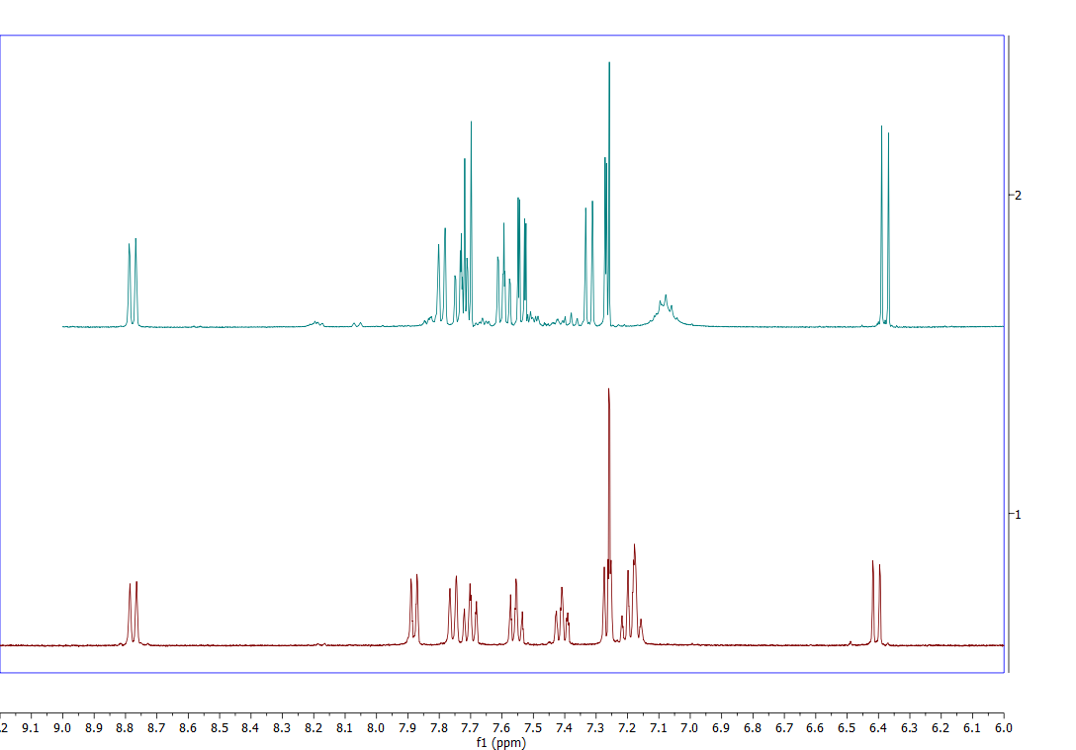
Synthesis and Characterization – NMR (2/2)
Notes:
The NMR spectra showcase the comparison of the regular 9H-fluorenone vs. the 2,7-dibromo-9-fluoreneone on the left side and compare the Spiro[dibenzo[c,h]xanthene-7,9'-fluorene] to the Dibromo Spiro[dibenzo[c,h]xanthene-7,9'-fluorene] on the right side.
STILL NEED TO INPUT NMR SPECTRA

Slide 9
Progress Forward With Brominated Spiro
The 2',7'-Dibromospiro[dibenzo[c,h]xanthene-7,9'-fluorene] system opens up a multitude of applications to synthesize variations in hole transporting materials.
Future work will include crafting variations of the Spiro molecule to assess the effectiveness of differing hole transport materials. (Reference 1)
Mg/THF + R
(Grignard's Reaction)
Two Methods
Using Dibenzosuberenone with a similar synthesis strategies
2,7-Dibromo-9H-fluorenone vs. Dibenzosuberenone
Notes:
The plan to continue working with products that have proved to be effective, while expanding on them with reagents like Grignard’s, while also trying new compounds with similar synthesis strategies.

Slide 10
Conclusion
Based off the characterization of the NMR, the Spiro complex was successfully synthesized.
The 9H-fluorenone derivatives prove to be applicable for further Spiro reactions for uses in perovskite X-ray detectors. (Reference 1 and 5)
  Potential applications:
    Medical Settings
    NASA Space Settings
    Planetary Research
OR
OR

Slide 11
References
(1) Li, L.; Lu, Z.; Yang, J.; Li, M.; Zhang, L.; Hai, J.; Liu, Y. Conjugated Copolymers of Triazoloquinoxaline-Alt-Fluorene with Imine Chain Bridge for Photovoltaic Solar Cells. Mater. Lett.. 2016, 175, 223–226. https://doi.org/10.1016/j.matlet.2016.04.009.
(2) Maciejczyk, M.; Ivaturi, A.; Robertson, N. SFX as a Low-Cost “Spiro” Hole-Transport Material for Efficient Perovskite Solar Cells. J. Mater. Chem. A. 2016, 4 (13), 4855–4863. https://doi.org/10.1039/c6ta00110f.
(3) Xu, B.; Bi, D.; Hua, Y.; Liu, P.; Cheng, M.; Grätzel, M.; Kloo, L.; Hagfeldt, A.; Sun, L. A Low-Cost Spiro[Fluorene-9,9′-Xanthene]-Based Hole Transport Material for Highly Efficient Solid-State Dye-Sensitized Solar Cells and Perovskite Solar Cells. Energy Environ. Sci.. 2016, 9 (3), 873–877. https://doi.org/10.1039/c6ee00056h.
(4) Zhang, X.; Han, J.-B.; Li, P.-F.; Ji, X.; Zhang, Z. Improved, Highly Efficient, and Green Synthesis of Bromofluorenones and Nitrofluorenones in Water. Synth. Commun.. 2009, 39 (21), 3804–3815. https://doi.org/10.1080/00397910902838904.
(5) Zheng, J.; Zhang, M.; Lau, C. F. J.; Deng, X.; Kim, J.; Ma, Q.; Chen, C.; Green, M. A.; Huang, S.; Ho-Baillie, A. W. Y. Spin-Coating Free Fabrication for Highly Efficient Perovskite Solar Cells. Sol. Energy Mater. Sol. Cells. 2017, 168, 165–171. https://doi.org/10.1016/j.solmat.2017.04.029.
Notes:
Need to input from computer in basement.

Slide 12
Thank You

